Slide 1
DECENTRALIZED VOTING SYSTEM USING ETHEREUM BLOCKCHAIN Under the Supervision of : In-house coordinator By: 1.Rahul Joshi 2.Chirag Arora 3.Aditya Sahu (Computer Science & Engineering) [Batch: 2016-2020]

Slide 2
CONTENTS
About the project
Technologies used
What is Blockchain ?
Ethereum
Smart contracts
Advantages ,Disadvantages
Applications
Implementation of project

Slide 3
Objective
A secure e-voting system that does not allow duplicated votes and is fully transparent, while protecting the privacy of the attendees. It will have the following advantages over the EVM machine currently used :
Creating a transparent environment for e-voting
Votes cannot be altered
Safer, cheaper, more secure, more transparent, and easier to use e-voting systems.

Slide 4
To be able to write smart contracts to use in development of
Creating a transparent environment for e-voting.
.

Slide 5
About the project
E-voting is a trending, yet critical topic related to the online services.
Ethereum and its network is one of the most suitable ones, due to its consistency, widespread use, and provision of smart contracts logic.
The blockchain with the smart contracts emerges as a good candidate to use in developments of safer, cheaper, more secure, more transparent, and easier-to-use e-voting systems.
In this project, we have implemented and tested a sample e-voting application as a smart contract for the Ethereum network using the Ethereum wallets and the Solidity language.

Slide 6
After an election is held the Ethereum blockchain will hold the records of ballots and votes.
Users can submit their votes directly from their Ethereum wallets.
These transaction requests are handled with the consensus of every single Ethereum node.
This consensus creates a transparent environment for e-voting.
Our e-voting system is secure, as it does not allow duplicated votes and is fully transparent, while protecting the privacy of the attendees.

Slide 7
Technologies Used
Ethereum
Ethereum is a cryptocurrency much like a bitcoin and is usually stated as Bitcoin successor .
it’s much more than a payment system — it’s an infrastructure.
Solidity
Solidity is a programming language for writing smart contracts.
Ex: think of it as a way to control a bank account with code.
Node.js
Deploying smart contracts in the backend.
Used for testing purpose.

Slide 8
react.js
A javascript library for building user interface.
web3.js
collection of libraries which allow you to interact with a local or remote ethereum node, using a HTTP or IPC connection

Slide 9
What is Blockchain ?
[A hash pointer linked list of blocks]
An append-only sequential data structure
New blocks can be appended at the end of the chain
To change a block in the middle of the chain ,all subsequent blocks need to be changed.
Disintermediated ,Distributed and Decentralized

Slide 10
Blockchain: A Distributed Transaction Ledger
Every block contains multiple transactions
Massively duplicated across network nodes
Shared with a P2P file transfer protocol
Updated by peculiar nodes , known as miners , appending new blocks of transactions.

Slide 11
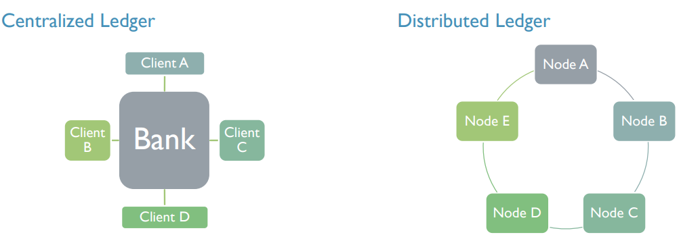
What is a Distributed Ledger ?
There are multiple ledgers, but Bank holds the “golden record”.
Client B must reconcile its own ledger against that of Bank, and must convince Bank of the “true state” of the Bank ledger if discrepancies arise.
There is one ledger. All Nodes have some level of access to that ledger.
All Nodes agree to a protocol that determines the “true state” of the ledger at any point in time. The application of this protocol is sometimes called “achieving consensus.”

Slide 12
WHAT IS ETHEREUM ?
Ethereum is a decentralized platform that runs smart contracts: applications that run exactly as programmed without any possibility of downtime, censorship, fraud or third party interference.

Slide 13
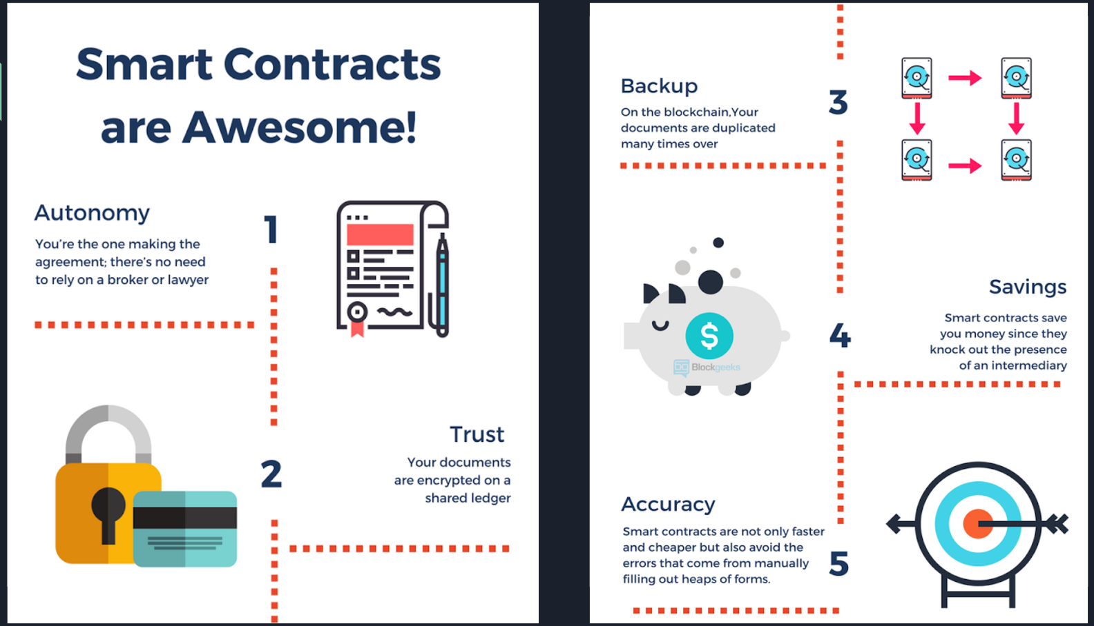
SMART CONTRACTS

Slide 14


Slide 15
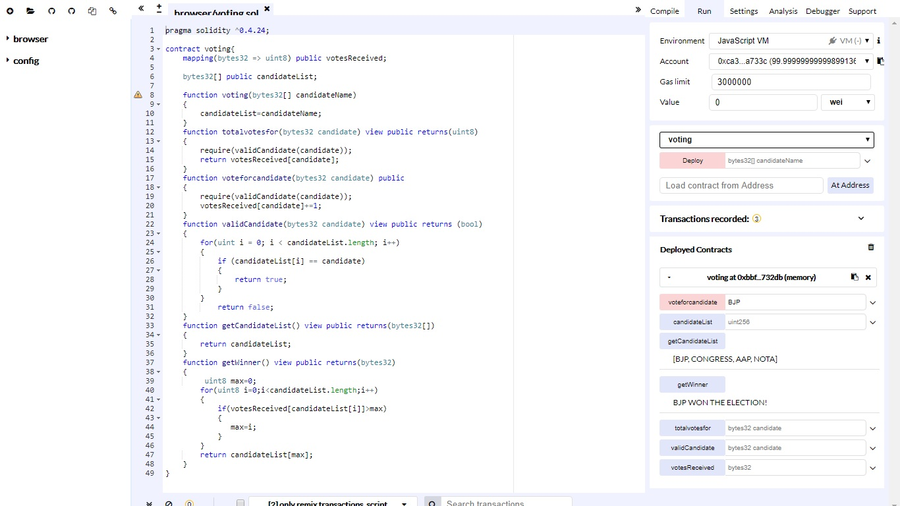
Compiling Solidity Code using Remix IDE

Slide 16
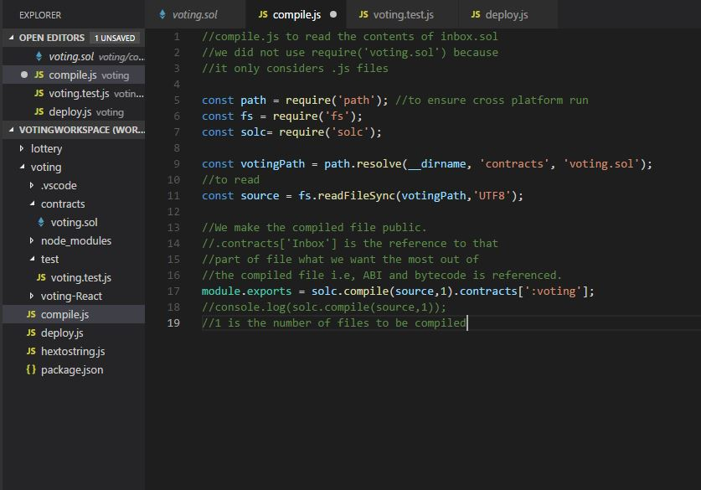
Compiling Smart Contracts Using Node.js

Slide 17
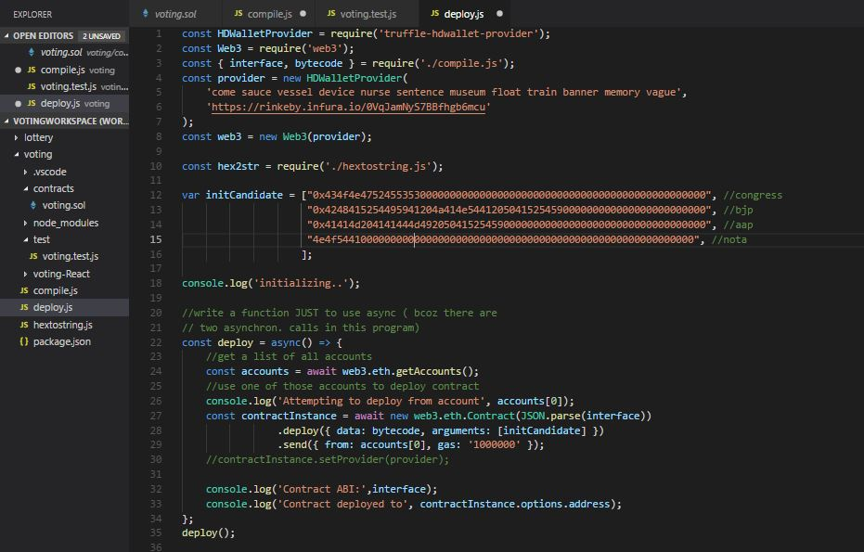
Deploying Smart Contract

Slide 18
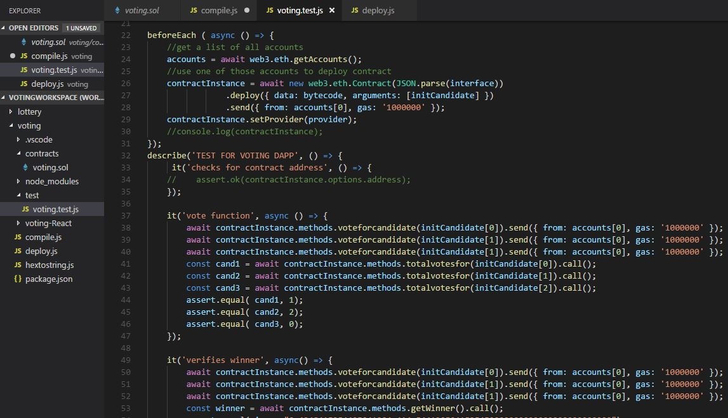
Testing & Maintenance of Smart Contracts

Slide 19
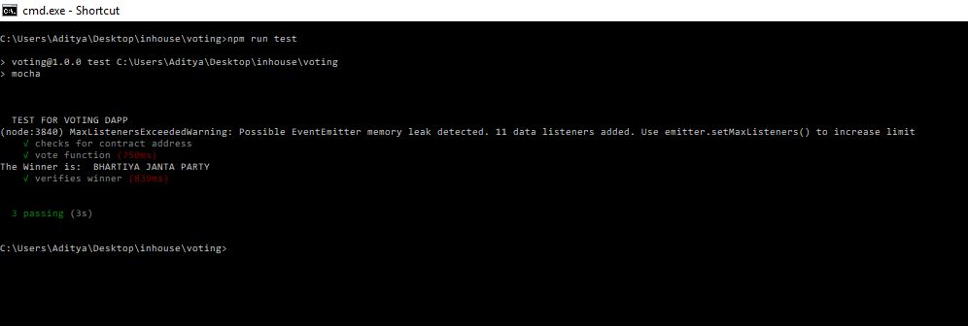

Slide 20
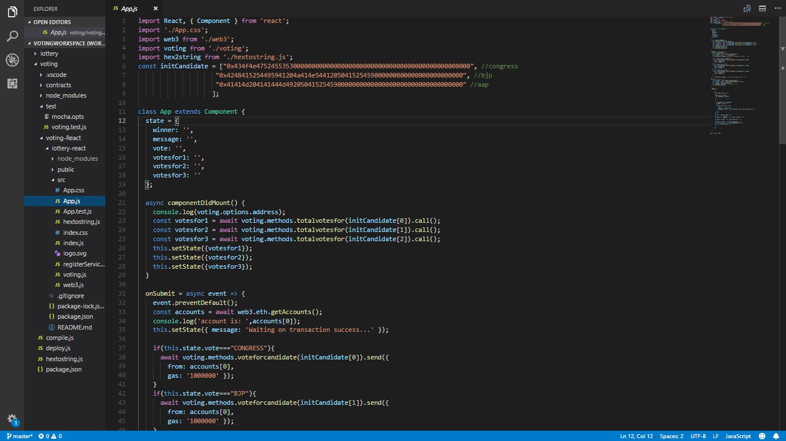
Building Interactive Frontends using React.js

Slide 21
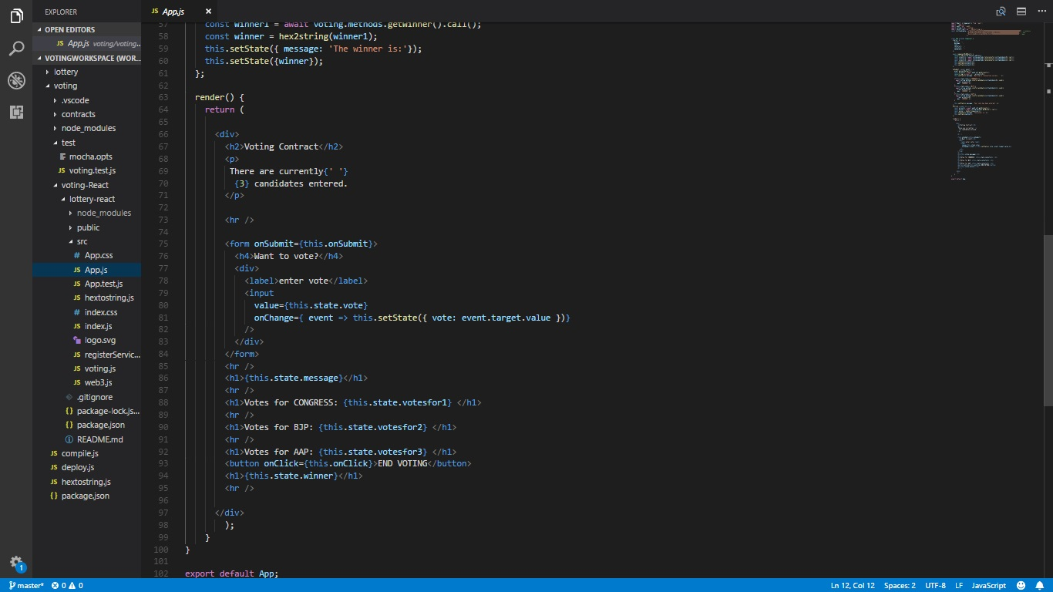

Slide 22
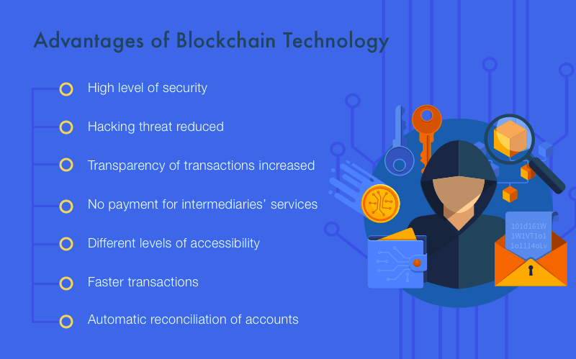

Slide 23
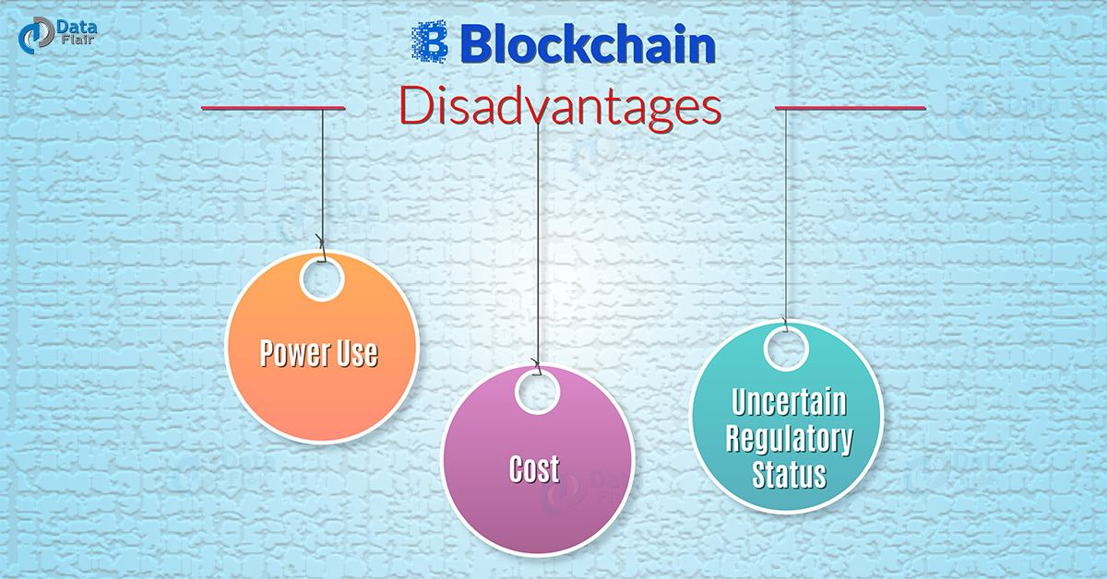

Slide 24
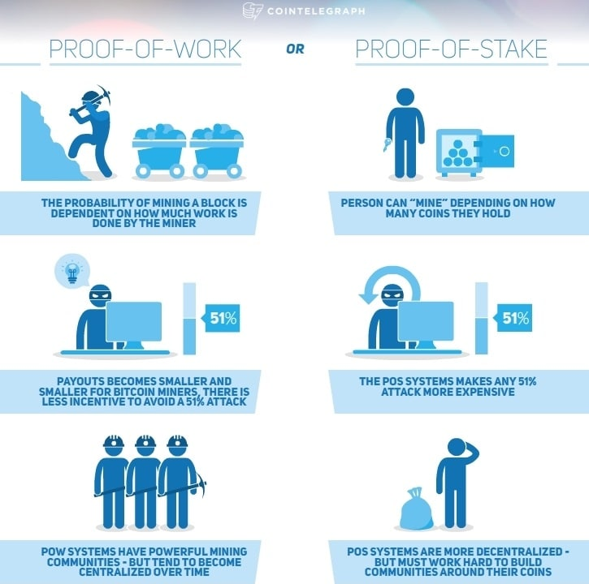
Proof Of Stake VS Proof Of Work

Slide 25
THANK YOU

